Slide 1

Learning how to learn
Collective Worship
7th September

Slide 2
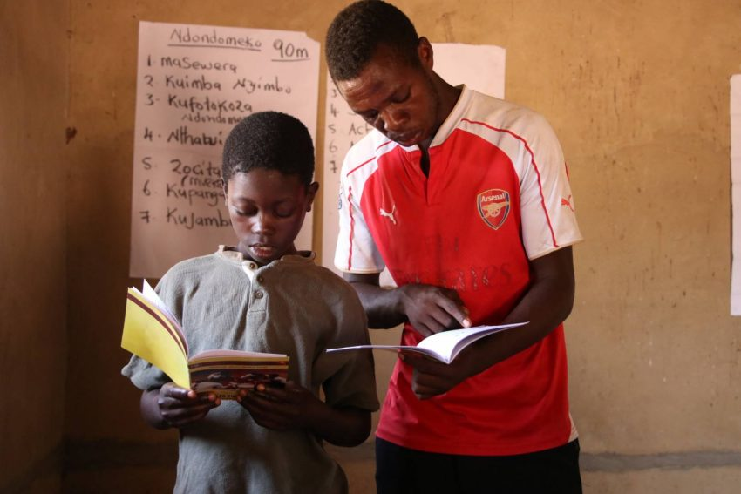
Opening prayer - thamkfulness
Father God, guide us today as we think about learning to learn. Help us to remember how privileged we are to come to a safe, thriving school. Guide us over the coming weeks as we learn to understand ourselves as learners. Help us to find our strengths but to also be comfortable with knowing what we need to develop.
In your wisdom Lord we will shine
Twelve-year-old Rabson gets the opportunity to read aloud at a reading camp held in his village every weekend. (©2020 World Vision/photo by Tigana Chileshe)

Slide 3
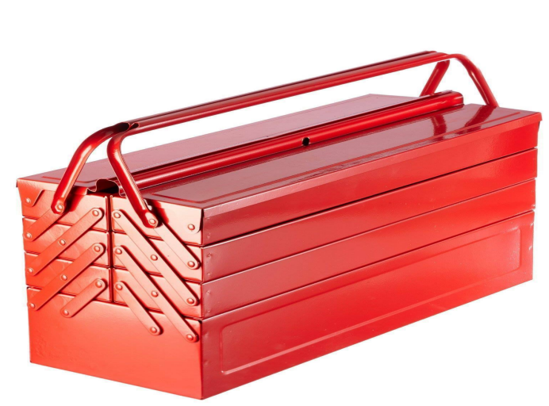
What should we put into a toolbox for learning?
What things do we need to learn successfully?

Slide 4

Did you put these things in?

Slide 5
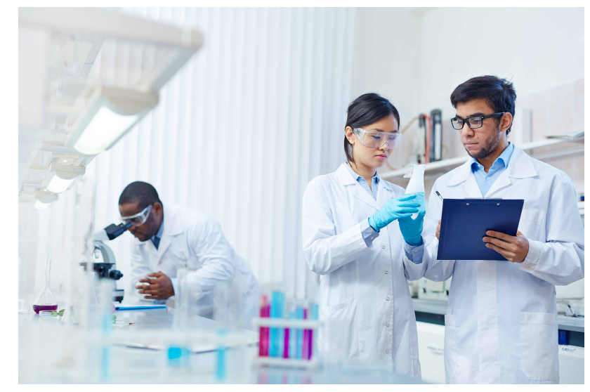
What else is needed?
Scientists tell us that to be a successful learner, we also have to have the right attitudes and characteristics in our toolboxes.

Slide 6
What attitudes and characteristics do you think we need?
Creativity
Deep-thinking
Being interested
Curiosity
Risk taking
Focus
Positive attitude
Resilience
Friends

Slide 7
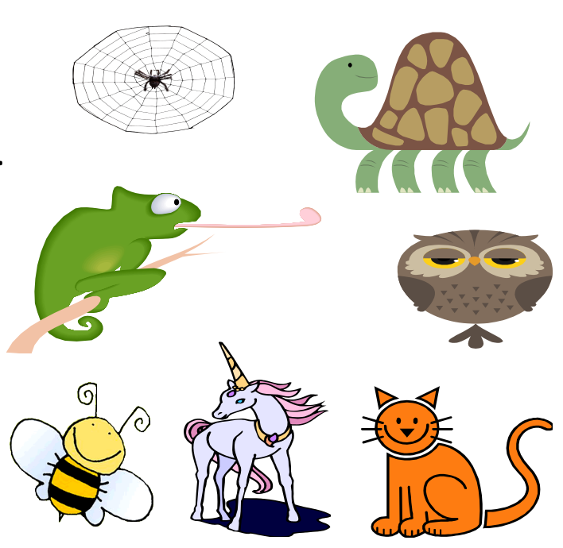
These animals can help us with our learning too
Each animal is good at doing something special that helps it to learn.
We are going to find out about each of these animals in more detail this year. Which ones can you name?

Slide 8
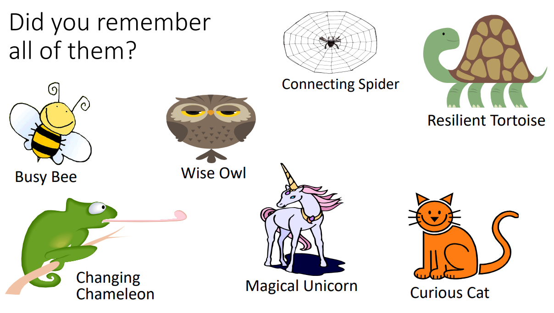
Did you know any?

Slide 9
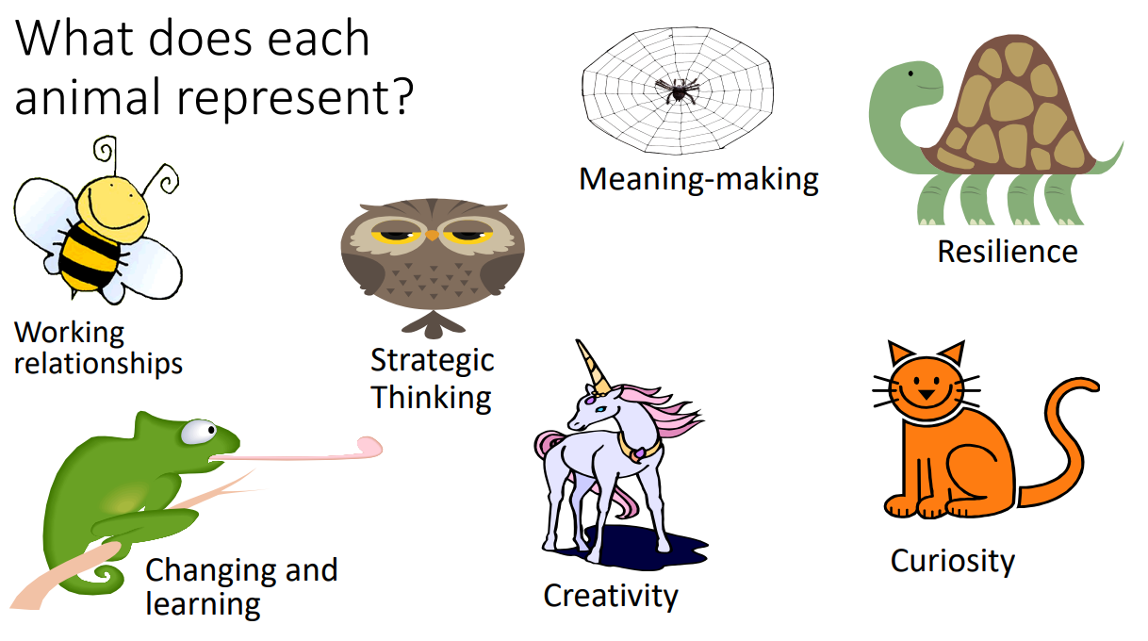

Slide 10
Which animal would help you to….
Keep on going when things aren’t easy?
See the bigger picture?
Link your ideas together?
Work with a partner or a friend?
Know you can get better at things if you try your best?
Ask lots of questions?
Take a risk or let ideas bubble out?

Slide 11
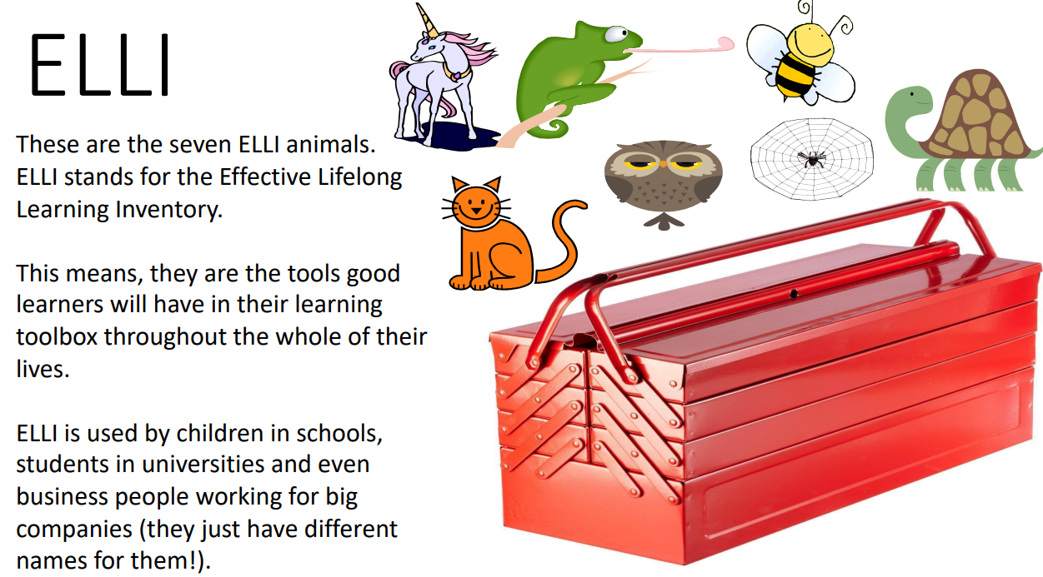
ELLI – Effective Life Long Learning Inventory

Slide 12
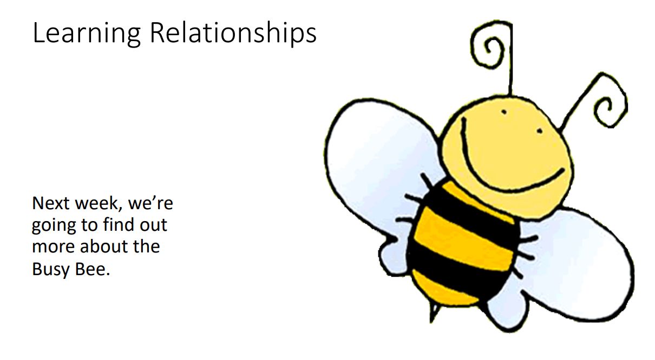

Slide 13
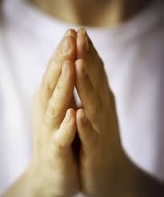

Let’s pray

