Slide 1


Our vision is that with faith and belief we can transform lives – not only in our school but also beyond, in our local and international communities, creating global citizens of the future who are stewards of the Earth. We want all our children to leave St Georges with the knowledge and skills to flourish in life, and the dispositions to help others to flourish as well
Reception Long
Term Plan
Our mission is to create classrooms where children achieve more than they think possible. Adults are supported to fulfil their highest aspirations, so that all members of our learning community can live life in all its fullness (John 10:10) and become active contributors to building a better world. St Georges’ citizens are stewards of the Earth. At St Georges we know that children and adults flourish when, through love and nurture, they are engaged in learning that is challenging, adventurous and meaningful. St Georges Church School and Nursery is committed to the philosophy that learning is limitless and everything is possible. We believe that there is a special spark in everyone, and that every child is intelligent and extraordinary.
2023/24

Slide 2

Reception Long Term Plan
 | Term 1 | Term 2 | Term 3 | Term 4 | Term 5 | Term 6
Over Arching Principles | Characteristics of Effective Learning Playing and exploring: - Children investigate and experience things, and ‘have a go’. Children who actively participate in their own play develop a larger store of information and experiences to draw on which positively supports their learning Active learning: - Children concentrate and keep on trying if they encounter difficulties. They are proud of their own achievements. For children to develop into self-regulating, lifelong learners they are required to take ownership, accept challenges and learn persistence. Creating and thinking critically: - Children develop their own ideas and make links between these ideas. They think flexibly and rationally, drawing on previous experiences which help them to solve problems and reach conclusions.
Over Arching Principles | Unique Child: Every child is unique and has the potential to be resilient, capable, confident and self-assured. Positive Relationships: Children flourish with warm, strong & positive partnerships between all staff and parents/carers. This promotes independence across the EYFS curriculum. Children and practitioners are NOT alone – embrace each community. Enabling environments: Children learn and develop well in safe and secure environments where routines are established and where adults respond to their individual needs and passions and help them to build upon their learning over time. Learning and Development: Children develop and learn at different rates .We must be aware of children who need greater support than others. We believe passionately in nurturing children’s curiosity, independence and creativity; promoting child-led learning and providing children with rich, open-ended, purposeful play experiences within our free-flowing indoor and outdoor learning environments. Our play-based, purposeful provision follows our children’s current interests and sensitively responds to the individual needs of the children and real-life situations. The children are empowered to take ownership of their learning; seek out care of their own wellbeing; become confident communicators and self-assured risk takers. Mark 9:23 All things are possible for one who believes.
CoEL

Slide 3

ELLI Characters
At St Georges, the Characteristics of Effective Learning are underpinned through the use of ELLI characters. These are used to build upon and strengthen the effective characteristics of learning, making them relatable for the children. The ELLI characters are woven like a golden thread throughout the curriculum, and reflected upon by every class in the school.
Through using ELLI, we create a powerful classroom learning culture that systematically cultivates habits and attitudes that enable young people to become better learners; face difficulty and uncertainty calmly, confidently and creatively. We therefore engage children consciously with ideas and processes of their own learning in the knowledge that learning itself is learnable.

Slide 4
What we learned during transition...
What our families, children and feeder settings told us... | Our response
Many children shy, nervous or anxious | Gentle transition to school and closer attention during transition weeks. Heavy focus on PSED during initial weeks with activities to develop self-confidence
Many children experience 'big feelings' | PSED programme 1decision to support understanding of feelings. Dr Treisman approach of 'name it to tame it.' Modelling language and naming our own feelings. Mindfulness and positive affirmations built into curriculum.
Children would benefit from developing resilience around hurting themselves | Initial focus on 'The resilient tortoise' and how this can support us to develop the CoEL. Whole class session in initial week on people in school who help us and what to do if we are physically hurt.
Of the 20 who returned 'all about me' forms, 3 chose not to draw self-portrait and 3 were not recognisable as people | Mark making opportunities inside and outside. Creative approaches such as paper under tables. Creation station part of continuous provision. Drawing club. Focus on pencil grip fine motor skills at fine motor zone.

Slide 5




Reception Long Term Plan
 | Term 1 | Term 2 | Term 3 | Term 4 | Term 5 | Term 6
General Themes NB: These themes may be adapted at various points to allow for children’s interests to flow through the provision | Explorers Exploring our classroom/ explore the school / Friendship/ settling in/ assessment / building relationships/ Autumn / seasons | Celebrations Remembrance day/ Diwali/ fireworks/ Christmas | Dinosaurs History/ UTW | Plants and growth Nature studies | Animals Human bodies/ Animals and animal parts | Around ThE world History and Geography
Possible Texts | Owl Babies Going On a Bear Hunt Words and Your Heart Three Billy Goats Gruff Room on the Broom The Great Big Book of Families Traditional fairy tales Fill a bucket of Kindness | Funny Bones Ava’s Poppy The Best Diwali Ever The magic Porridge Pot Button Moon-Planet Donut Stick Man Christmas Story / Nativity Rama and Sita | Dinosaur Pooped a Planet Harry’s Bucket full of Dinosaurs Stomp, Chomp, Big Roars. Dinosaurs Love Underpants | Jasper’s Beanstalk Jack and the Beanstalk A Seed Grows The Carrot Seed Amazing life cycle of plants. Nonfiction on Plants Little Rose | Somebody Swallowed Stanley Peter Rabbit Brown bear, Brown Bear what do you See? What the Ladybird Heard | Seaside Jobs Sea, Sand, me The Strom Whale The Snail and the Whale Monkey Puzzle Sharing a Shell
Reading Spine | Mrs. Armitage on Wheels Shhh! Farmer Duck Gruffalo |  | Six Dinner Sid Whatever Next Handas Surprise Mr Gumpy’s Outing |  | Owl Babies Good night, Moon On the Way home Rosie’s Walk.
‘Wow’ moments / Visits and Visitors | Teacher's visiting me at Home Harvest Time Forest School Weston Hospice Visit | Remembrance Day Guy Fawkes / Bonfire Night Christmas Time / Nativity Diwali Children in Need Anti- Bullying Week Open the Book Visit PCSO visit- crossing roads Police Officer visit Firefighter visit | Chinese New Year Children's mental health week Valentine’s Day Internet Safety Day Open the Book Visit Governor visit/Parent visit Dinosaur Museum – parents invited | LENT – from 14th Feb Random acts of kindness week – wb 19h Feb Easter time Mother’s Day Open the Book Visit World Book Day Chicken expert Farmlink visits Planting with care home | Start of Ramadan Eid Open the Book Visit Woodland walk | Father’s Day Heathy Eating Week World Environment Day Anniversary of the NHS Open the Book Visit Court Farm Trip

Slide 6
Reception Long Term Plan
 | Term 1 | Term 2 | Term 3 | Term 4 | Term 5 | Term 6
British Values Assemblies / Sharing Circles | . Democracy We all have the right to be listened to. We respect everyone and we value their different ideas and opinions. We have the opportunity to play with who we want to play with. We listen with intrigue and value and respect the opinions of others. | Mutual respect We are all unique. We respect differences between different people and their beliefs in our community, in this country and all around the world. All cultures are learned , respected, and celebrated | Mutual Tolerance Everyone is valued, all cultures are celebrated, and we all share and respect the opinions of others. Mutual tolerance of those with different faiths and beliefs and for those without faith. | Rule of law We all know that we have rules at school that we must follow. We know who to talk to if we do not feel safe. We know right from wrong. We recognise that we are accountable for our actions. We must work together as a team when it is necessary. | Individual liberty We all have the right to have our own views. We are all respected as individuals. We feel safe to have a go at new activities. We understand and celebrate the fact that everyone is different. | Recap all British Values Fundamental British Values underpin what it is to be a citizen in a modern and diverse Great Britain valuing our community and celebrating diversity of the UK. Fundamental British Values are not exclusive to being British and are shared by other democratic countries.
St Georges School Values | Community & Friendship | Respect | Trust & Forgiveness | Service | Thankfulness | Hope
Assessment opportunities | Analyse transfer documents National Baseline data by end of term Phonic Intervention groups Parents evening SENDCO Meeting | On going assessments Baseline analysis Pupil progress meetings Data drop EYFS Moderation | Moderation Pupil progress meetings Phonic assessment | EYFS Trust Network Meeting Pupil progress meetings Parents evening Phonic assessment | Phonic assessment | Pupil progress meetings EOY data Phonic assessment
Parental Involvement | Staggered Start /half days Home visits Home / School Agreement Dojo Phonics workshop | Dojo Nativity performance Parents Evening | Dojo Share a story Dinosaur Museum | Dojo Parents Evening Blending workshop Invited in to see eggs and chicks – younger sibling links. | Parents invited in at end of term to watch video of terms learning Class worship Dojo | Parents invited to join for sponsored walk Dojo

Slide 7

Reception Long Term Plan
 | Term 1 | term 2 | term 3 |  | Term 4 | Term 5 |  | Term 6
Communication and Language Talk to parents about what language they speak at home, try and learn a few key words and celebrate multilingualism in your setting. | The development of children’s spoken language underpins all seven areas of learning and development. Children’s back-and-forth interactions from an early age form the foundations for language and cognitive development. The number and quality of the conversations they have with adults and peers throughout the day in a language-rich environment is crucial. By commenting on what children are interested in or doing, and echoing back what they say with new vocabulary added, practitioners will build children's language effectively. Reading frequently to children, and engaging them actively in stories, non-fiction, rhymes and poems, and then providing them with extensive opportunities to use and embed new words in a range of contexts, will give children the opportunity to thrive. Through conversation, story-telling and role play, where children share their ideas with support and modelling from their teacher, and sensitive questioning that invites them to elaborate, children become comfortable using a rich range of vocabulary and language structures.
C&L is developed throughout the year through high quality interactions, daily group discussions, sharing circles, PSHE times, stories, singing, Pie Corbett T4W actions, EYFS productions, and daily worship. | Listening, Attention and Understanding Listen attentively in 1:1, small group and whole class discussions To engage in conversations Speaking To participate in small group, class and 1:1 discussions Consider why things might happen Verbally express ideas and feelings Implementation Poetry basket – recite poems orally with actions Story time – To listen to and enjoy whole class and small group story time |  |  | Listening, Attention and Understanding Listen attentively in 1:1, small group and whole class discussions, responding to what they hear with relevant comments and actions To hold conversations in a back and forth exchange Speaking To participate in small group, class and 1:1 discussions, offering their own ideas Consider why things might happen, offering explanations Verbally express ideas and feelings about their experiences, with modelling and support from their teacher Implementation Poetry basket – recite poems orally with actions and then offering their ideas, thoughts and feelings in response. Story time – To listen to and enjoy whole class and small group story time, offering their own ideas and feelings about the story, with modelling and support from the teacher |  |  | Listening, Attention and Understanding Listen attentively in 1:1, small group and whole class discussions, responding to what they hear with relevant comments, actions and questions to clarify understanding To hold conversation, when engaged, in back and forth exchanges with teachers in peers. Speaking To participate in small group, class and 1:1 discussions, offering their own ideas using recently introduced vocabulary Consider why things might happen, offering explanations, using recently introduced vocabulary Verbally express ideas and feelings about their experiences using full sentences including use of past, present and future tenses and making use of conjunctions, with modelling and support from their teacher. Implementation Poetry basket – recite poems orally with actions and then offering their ideas, thoughts and feelings in response, making use of conjunctions and questions to clarify understanding. Story time – To listen to and enjoy whole class and small group story time, offering their own ideas and feelings and questions about the story, using conjunctions, with modelling and support from the teacher

Slide 8

Reception Long Term Plan 21-22
 | Term 1 | Term 2 | Term 3 | Term 4 | Term 5 | Term 6-ELG
Personal, Social and Emotional Development | Children’s personal, social and emotional development (PSED) is crucial for children to lead healthy and happy lives, and is fundamental to their cognitive development. Underpinning their personal development are the important attachments that shape their social world. Strong, warm and supportive relationships with adults enable children to learn how to understand their own feelings and those of others. Children should be supported to manage emotions, develop a positive sense of self, set themselves simple goals, have confidence in their own abilities, to persist and wait for what they want and direct attention as necessary. Through adult modelling and guidance, they will learn how to look after their bodies, including healthy eating, and manage personal needs independently. Through supported interaction with other children, they learn how to make good friendships, co-operate and resolve conflicts peaceably. These attributes will provide a secure platform from which children can achieve at school and in later life.
Self - Regulation Managing Self Building Relationships | Getting to know you * Making friends * Establishing routines Developing ownership of classroom Managing and understanding personal hygiene Understanding rules and the reasons behind these Give focused attention to what the teacher says and respond appropriately Implementation: 1decsion resources |  | Forming positive attachments to adults and friendships with peers Expanding our friendship circle Show sensitivity to our own and others needs Know right from wrong and try to behave accordingly Set and work towards simple goals Understanding the importance of healthy food choices Follow instructions involving several ideas or actions Implementation: 1decsion resources |  | Work and play cooperatively and take turns with others Be confident to try new activities and show Independance, resilience and perseverance in the face of a challenge Implementation: 1decsion resources

Slide 9

Reception Long Term Plan
 | term 1 | Term 2 |  | term 3 | Term 4 | Term 5 | Term 6-ELG
Physical development Fine motor development is offered daily in both planned daily invitations in the fine motor zone as well as through paintbrushes, small tools, scissors and cutlery in continuous provision. . | Physical activity is vital in children’s all-round development, enabling them to pursue happy, healthy and active lives. Gross and fine motor experiences develop incrementally throughout early childhood, starting with sensory explorations and the development of a child’s strength, co-ordination and positional awareness through tummy time, crawling and play movement with both objects and adults. By creating games and providing opportunities for play both indoors and outdoors, adults can support children to develop their core strength, stability, balance, spatial awareness, co-ordination and agility. Gross motor skills provide the foundation for developing healthy bodies and social and emotional well-being. Fine motor control and precision helps with hand-eye co-ordination, which is later linked to early literacy. Repeated and varied opportunities to explore and play with small world activities, puzzles, arts and crafts and the practice of using small tools, with feedback and support from adults, allow children to develop proficiency, control and confidence.
Fine motor | Fine motor including handwriting: *To begin to hold a pencil effectively 'Point away the pencil, pinch it near the tip, lift it off the table, spin it round and grip.' To enjoy drawing Implementation: ELS handwriting patters Drawing club EAD input |  | Fine motor including handwriting: *To begin to hold a pencil effectively, using the tripod grip in almost all cases To begin to draw with care Implementation: ELS handwriting patters Letter join Drawing club EAD input |  |  | Fine motor including handwriting: Begin to hold a pencil effectively in preparation for fluent writing - using the tripod grip in almost all cases To begin to show accuracy and care when drawing Implementation: ELS handwriting patters Letter join Drawing club EAD input
PE Lessons – complete PE | Walking | Hands 1 - CP Dinosaurs |  | Hands 2 - CP PE lesson -High, low, over, under | Feet 1 - CP Moving | Jumping 1 - CP Nursery rhymes | Games for understanding. Rackets, bats, balls and balloons.

Slide 10

Reception Long Term Plan 21-22 Cycle 1
 | Term 1 | term 2 | Term 3 | Term 4 | Term 5 | Term 6
Literacy Comprehension Word Reading, Writing and Spelling | It is crucial for children to develop a life-long love of reading. Reading consists of two dimensions: language comprehension and word reading. Language comprehension (necessary for both reading and writing) starts from birth. It only develops when adults talk with children about the world around them and the books (stories and non-fiction) they read with them, and enjoy rhymes, poems and songs together. Skilled word reading, taught later, involves both the speedy working out of the pronunciation of unfamiliar printed words (decoding) and the speedy recognition of familiar printed words. Writing involves transcription (spelling and handwriting) and composition (articulating ideas and structuring them in speech, before writing)
Literacy Comprehension | To enjoy listening to stories and demonstrate an understanding of what has been read to them To anticipate/predict key events in stories To understand recently introduced vocabulary Implementation: Story time, Drawing club Decodable readers |  | To enjoy listening to stories and demonstrate an understanding of what has been read to them by retelling stories and narratives using their own words To anticipate/predict key events in stories To understand and use recently introduced vocabulary Implementation: Story time, Drawing club Talk for writing Decodable readers |  | To enjoy listening to stories and demonstrate an understanding of what has been read to them by retelling stories and narratives using their own words and recently introduced vocabulary To anticipate/predict key events in stories To understand and use recently introduced vocabulary during discussions Implementation: Story time, Drawing club Talk for writing Decodable readers
Word Reading | Phonics: Phase 2 – s,a,t,p,I,n,m,d,g,o,c,k,ck,e,u,r,ss,h,b,f,ff,l,ll H2RASW's: I, the, no, put, of, is, to, go, into, pull, as, his | Phonic Sounds: Phase 3 - J,v,w,x,y,z,zz,q,u,ch,sh,th,ng,nk,ai,ee,igh,oa, H2RASW's He, she, buses, we,me, be, push, was, her, my, you . | Phonic Sounds: Phase 3 and 4 Oo, ar, ur, oo, or, ow, oi, ear, air, ure, er, ow H2RASW's They, all, are, ball, tall, when, what | Phonic Sounds: Review weeks H2RASW's Said, so, have, were, out, like, some, come, there, little, one, do, children, love | Phonics Sounds: Phase 4 Cvcc, ed, er, est | Phonics sounds: Phase 5 introduction Ay, ou, ie, ea, le, oy, ir, ue, aw, wh, ph, ew, oe, au, ey, a-e, e-e, I-e, oo-e, u-e, c H2RASW's Oh, their, people. Mr,Mmrs, your, ask, should would, could asked, house, mouse, water, want, very.

Slide 11
Reception Long Term Plan
 | term1 | term 2 | Term 3 | Term 4 | Term 5 | Term 6
Writing Letter Formation | Fine motor including handwriting: *To begin to hold a pencil effectively 'Point away the pencil, pinch it near the tip, lift it off the table, spin it round and grip.' To enjoy drawing Implementation: ELS handwriting patters Drawing club EAD input Write phonemes Write some simple CVC words. Implementation -drawing club |  | Fine motor including handwriting: *To begin to hold a pencil effectively, using the tripod grip in almost all cases To begin to draw with care Implementation: ELS handwriting patters Letter join Drawing club EAD input Write some simple CVC words. Write captions/ phrases. Begin to write sentences. Begin to understand what a sentence is made of (Capital letter, noun, verb and full stop) Implementation -drawing club Talk for Writing. |  | Fine motor including handwriting: Begin to hold a pencil effectively in preparation for fluent writing - using the tripod grip in almost all cases To begin to show accuracy and care when drawing Implementation: ELS handwriting patters Letter join Drawing club EAD input Write captions/ phrases that can be read by others. Write sentences that can be read by others. Implementation -drawing club Talk for Writing.
Writing

Slide 12

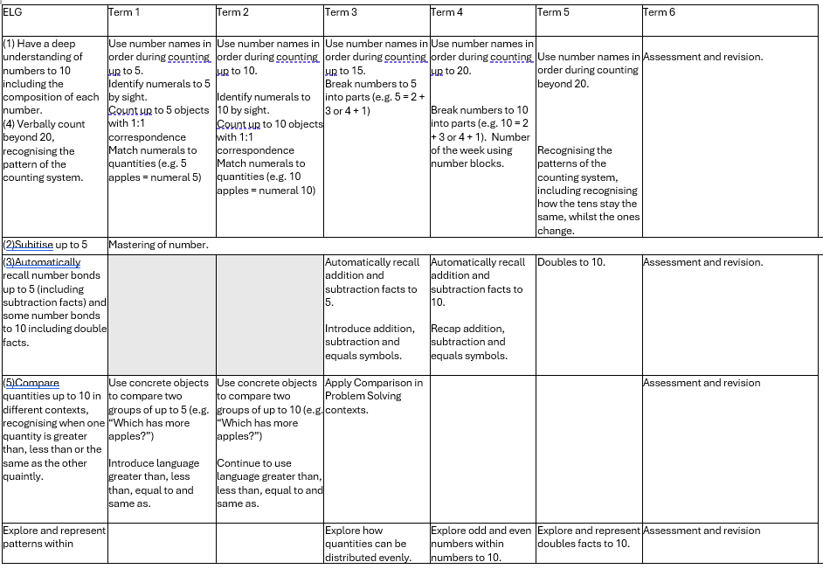
Reception Long Term Plan – Maths and Mastering number

Slide 13
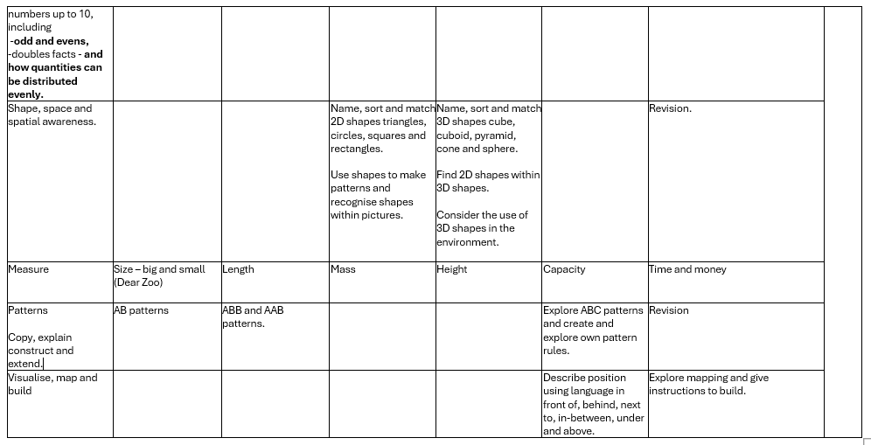
Reception Long Term Plan

Slide 14

Reception Long Term Plan 21-22 Cycle 1
 | Term 1 | Term 2 | Term 3 | Term 4 |  | Term 5 | Term 6
Understanding the world | Explorers Exploring our classroom/ explore the school / Friendship/ settling in/ assessment / building relationships/ Autumn / seasons | Celebrations Remembrance day/ Diwali/ fireworks/ Christmas | Dinosaurs History/ UTW | Plants and growth Nature studies |  | Animals Human bodies/ Animals and animal parts | Around THE world History and Geography Comparing holiday destinations (hot and cold)
Past and present | Talk about the lives of the people around them and their roles in society | Know some similarities and differences between things in the past and now, drawing on their experiences and what has been read in class Understand the past through settings, characters and events encountered in books, read in class and storytelling | Know some similarities and differences between things in the past and now, drawing on their experiences and what has been read in class Understand the past through settings, characters and events encountered in books, read in class and storytelling |  |  | Talk about the lives of the people around them and their roles in society | Know some similarities and differences between things in the past and now, drawing on their experiences and what has been read in class *Understand the past through settings, characters and events encountered in books, read in class and storytelling
People, culture and communities Similarities and difference between life in this country and life in other countries, during on knowledge from stories, non-fiction texts and maps. Is covered through the year through celebrations of special days | Describe their immediate environment using knowledge from observation, discussion, stories, non-fiction texts and maps. | Know some similarities and differences between different religious and cultural communities in this country, drawing on their experiences and what has been read in class. |  |  | Describe their immediate environment using knowledge from observation, discussion, stories, non- fiction texts and maps. |  | Describe their immediate environment using knowledge from observation, discussion, stories, non- fiction texts and maps. Explain some similarities and difference between life in this country and life in other countries, during on knowledge from stories, non-fiction texts and maps.
The Natural World |  |  | Understand some important processes and changes in the natural world around them, including the seasons and changing states of matter. |  | Explore the natural world around them, making observations and drawing pictures of animals and plants. Understand some important processes and changes in the natural world around them, including the seasons and changing states of matter. | Explore the natural world around them, making observations and drawing pictures of animals and plants. | Know some similarities and differences between the natural world around them and contrasting environments, drawing on their experiences and what has been read in class.

Slide 15


Reception Long Term Plan
 | Term 1 | Term 2 | Term 3 | Term 4 | Term 5 | Term 6
RE | The aim of RE in the foundation stage is essentially the same as that in other stages of a child’s education, namely, ‘to learn about and learn from religious and spiritual insights, beliefs and practices.’ During the foundation stage children begin to explore the world of religion in terms, for example, of special people, books, times, places and objects, and visiting places of worship.
Discovery RE and Understanding Christianity . | DRE Theme: Special People Key Question: What makes people special? Religion: Christianity | UC Concept: Incarnation Key Question: Why do Christians perform Nativity plays at Christmas Religion: Christianity | UC Concept: Creation Key Question: Why is the word ‘God’ so important to Christians? Religion: Christianity | UC Concept: Salvation Key Question: Why do Christians put a cross in an Easter garden? Religion: Christianity | DRE Theme: Stories Key Question: What can we learn from stories? Religion: variety | DRE Theme: Special Places Key Question: What makes places special? Religion: variety
ELG | * Know some similarities and differences between different religious and cultural communities in this country, drawing on their experiences and what has been read in class.
Special Days | Rosh Hashanah Yom Kippur Sukkot All Saints Day | Diwali Hanukkah Christmas St Andrews day | Epiphany Ash Wednesday / Shrove Tuesday St David’s Day Shivaratri St Patricks day | Holi Palm Sunday Passover Easter Start of Ramadan | Eid Shavuot St Georges day VE day

Slide 16




Reception Long Term Plan
 | Term 1 | term 2 | Term 3 | Term 4 | Term 5 | Term 6
Expressive Arts and Design Creating with materials . Being imaginative and expressive Music curriculum supported by Charanga scheme- weekly lesson | The development of children’s artistic and cultural awareness supports their imagination and creativity. It is important that children have regular opportunities to engage with the arts, enabling them to explore and play with a wide range of media and materials. The quality and variety of what children see, hear and participate in is crucial for developing their understanding, self-expression, vocabulary and ability to communicate through the arts. The frequency, repetition and depth of their experiences are fundamental to their progress in interpreting and appreciating what they hear, respond to and observe. Give children an insight into new musical worlds. Invite musicians in to play music to children and talk about it. Encourage children to listen attentively to music. Discuss changes and patterns as a piece of music develops.
Expressive Arts and Design Painting, 3D modelling, messy play, collage, cutting, drama, role play, threading, moving to music, clay sculptures, following music patterns with instruments, singing songs linked to topics, making instruments, percussion. Children to produce a piece of art work each half term to be displayed for ‘Celebration wall’ for school / parents to show how drawings have developed - lots of links to Fine Motor Skills. Children to explain their work to others. Children will have opportunities to learn and perform songs, nursery rhymes and poetry linked to their work / interests and passions. | Safley use and explore a variety of materials, tools and techniques, experimenting with colour and form. Explore primary colours Share their creations. Paint a portrait. Firework paintings. Make use of props and materials when role playing characters in narratives and stories. Invent narratives and stories with peers and their teacher. Sing a range of well-known nursery rhymes and songs. Perform songs, rhymes and poems with others and when appropriate try to move in time with the music. Implementation Drawing club Poetry basket Nursery rhymes and songs Creation station Movement breaks |  | *Safley use and explore a variety of materials, tools and techniques, experimenting with design and texture. Explore primary and secondary colours- Kandinsky. Paint a flower- Vincent Van Gogh Share their creations, explaining the process they have used. Make use of props and materials when role playing characters in narratives and stories. Invent and recount narratives and stories with peers and their teacher. Perform songs, rhymes, poems and stories with others and when appropriate try to move in time with the music. Implementation Drawing club Poetry basket Nursery rhymes and songs Creation station Movement breaks Helicopter stories |  | Safley use and explore a variety of materials, tools and techniques, experimenting with colour, design, texture, form and function. Share their creations, explaining the process they have used. Junk modelling. Make use of props and materials when role playing characters in narratives and stories. Invent, adapt and recount narratives and stories with peers and their Teacher. Perform songs, rhymes, poems and stories with others and when appropriate try to move in time with the music. Implementation Drawing club Poetry basket Nursery rhymes and songs Creation station Movement breaks Helicopter stories

Slide 17

Reception Long Term Plan
 | Term 1 | Term 2 | Term 3 | Term 4 | Term 5 | Term 6
E-safety Project Evolve . | Self-image and self identity | Online relationships and online identity | Online bullying | Managing online information | Health, wellbeing and lifestyle. Privacy and security | Copyright and ownership

Slide 18






Reception Long term plan
Early Learning Goals – for the end of the year - Holistic / best fit Judgement | Early Learning Goals | Autumn 2 | Spring 1 | Spring 2 | Summer 1 | Summer 2
Communication and Language | Personal, social, emotional development | Physical Development | Literacy | Maths | Understanding the World | Expressive arts and design
ELG: Listening, Attention and Understanding Listen attentively and respond to what they hear with relevant questions, comments and actions when being read to and during whole class discussions and small group interactions Make comments about what they have heard and ask questions to clarify their understanding Hold conversation when engaged in back-and-forth exchanges with their teacher and peers ELG: Speaking Participate in small group, class and one-to-one discussions, offering their own ideas, using recently introduced vocabulary. Offer explanations for why things might happen, making use of recently introduced vocabulary from stories, non-fiction, rhymes and poems when appropriate. Express their ideas and feelings about their experiences using full sentences, including use of past, present and future tenses and making use of conjunctions, with modelling and support from their teacher. | ELG: Self-Regulation Show an understanding of their own feelings and those of others, and begin to regulate their behaviour accordingly. Set and work towards simple goals, being able to wait for what they want and control their immediate impulses when appropriate. Give focused attention to what the teacher says, responding appropriately even when engaged in activity, and show an ability to follow instructions involving several ideas or actions. ELG: Managing Self Be confident to try new activities and show independence, resilience and perseverance in the face of challenge. Explain the reasons for rules, know right from wrong and try to behave accordingly. Manage their own basic hygiene and personal needs, including dressing, going to the toilet and understanding the importance of healthy food choices. ELG: Building Relationships Work and play cooperatively and take turns with others. Form positive attachments to adults and friendships with peers;. Show sensitivity to their own and to others’ needs. | ELG: Gross Motor Skills Negotiate space and obstacles safely, with consideration for themselves and others. Demonstrate strength, balance and coordination when playing. Move energetically, such as running, jumping, dancing, hopping, skipping and climbing. ELG: Fine Motor Skills Hold a pencil effectively in preparation for fluent writing – using the tripod grip in almost all cases. Use a range of small tools, including scissors, paint brushes and cutlery. Begin to show accuracy and care when drawing. | ELG: Comprehension Demonstrate understanding of what has been read to them by retelling stories and narratives using their own words and recently introduced vocabulary. Anticipate – where appropriate – key events in stories. Use and understand recently introduced vocabulary during discussions about stories, non-fiction, rhymes and poems and during role-play. ELG: Word Reading Say a sound for each letter in the alphabet and at least 10 digraphs. Read words consistent with their phonic knowledge by sound-blending. Read aloud simple sentences and books that are consistent with their phonic knowledge, including some common exception words. ELG: Writing Write recognisable letters, most of which are correctly formed. Spell words by identifying sounds in them and representing the sounds with a letter or letters. Write simple phrases and sentences that can be read by others. | ELG: Number Have a deep understanding of number to 10, including the composition of each number; Subitise (recognise quantities without counting) up to 5; - Automatically recall (without reference to rhymes, counting or other aids) number bonds up to 5 (including subtraction facts) and some number bonds to 10, including double facts. ELG: Numerical Patterns Verbally count beyond 20, recognising the pattern of the counting system; - Compare quantities up to 10 in different contexts, recognising when one quantity is greater than, less than or the same as the other quantity. Explore and represent patterns within numbers up to 10, including evens and odds, double facts and how quantities can be distributed equally. | ELG: Past and Present Talk about the lives of the people around them and their roles in society. Know some similarities and differences between things in the past and now, drawing on their experiences and what has been read in class. Understand the past through settings, characters and events encountered in books read in class and storytelling. ELG: People, Culture and Communities Describe their immediate environment using knowledge from observation, discussion, stories, non-fiction texts and maps. Know some similarities and differences between different religious and cultural communities in this country, drawing on their experiences and what has been read in class. Explain some similarities and differences between life in this country and life in other countries, drawing on knowledge from stories, non-fiction texts and – when appropriate – maps. ELG: The Natural World Explore the natural world around them, making observations and drawing pictures of animals and plants. Know some similarities and differences between the natural world around them and contrasting environments, drawing on their experiences and what has been read in class. Understand some important processes and changes in the natural world around them, including the seasons and changing states of matter. | ELG: Creating with Materials Safely use and explore a variety of materials, tools and techniques, experimenting with colour, design, texture, form and function. Share their creations, explaining the process they have used; - Make use of props and materials when role playing characters in narratives and stories. ELG: Being Imaginative and Expressive Invent, adapt and recount narratives and stories with peers and their teacher. Sing a range of well-known nursery rhymes and songs; Perform songs, rhymes, poems and stories with others, and – when appropriate – try to move in time with music.

